Slide 1


SAP UI5 FIORI
Additional Topics (ABAP CDS And GIT Hub)
www.zarantech.com
© Copyright 2021, ZaranTech LLC. All rights reserved.

Slide 2

Disclaimer
2
This presentation, including examples, images, and references are provided for informational purposes only.
Complying with all applicable copyrights laws is the responsibility of the user.
Without limiting the rights under copyright, no part of this document may be reproduced, stored or introduced into a retrieval system, or transmitted in any form or by any means.
Credits shall be given to the images taken from the open-source and cannot be used for promotional activities.

Slide 3
Agenda
3
FIORI Elements
Types of SAP Fiori Element Floorplans
CDS Views
JavaScript Promises
GITHUB Overview

Slide 4

FIORI Elements
2
AP Fiori elements is a UI library that provides several standard floorplans that significantly boost developer productivity by reducing the amount of user interface (UI) code they need to write and maintain.
You choose an SAP Fiori elements floorplan based on the requirements of your app. While the floorplan determines the overall layout of your app, metadata allows you to fine-tune what information is displayed within the floorplan.
‹#›

Slide 5
Business Benefits
2
SAP Fiori elements includes simple operations, such as navigation between pages or between apps, “SAP Fiori elements significantly boosts developer productivity by reducing the amount of user interface (UI) code they need to write and maintain.”
SAP Fiori elements templates reduce the amount of front-end development required to create your application. This allows you to focus on the back-end services while leveraging our proven UI concepts
The SAP Fiori elements floorplans enforce UX consistency across custom and standard SAP apps, which reduces the time spent on design reviews to ensure that your apps follow the guidelines you have set.
‹#›

Slide 6
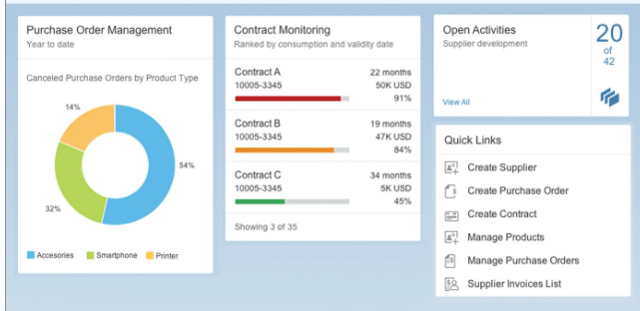
Types of SAP Fiori Element Floorplans
2
Overview Page: The SAP Fiori overview page application is a type of floor plan with a UI framework that provides quick access to vital business information at a glance.
This is in the form of actionable cards on a single page, enabling users to make faster decisions and focus on their most important tasks.
‹#›

Slide 7
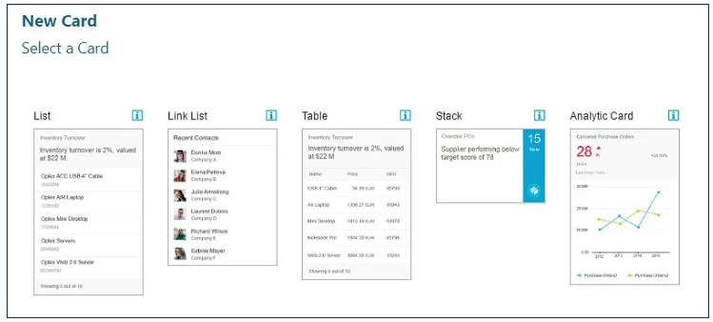
Types of SAP Fiori Element Floorplans
2
Cards are containers for app content, and they represent an entry-level view of the most relevant app data for a given topic.
The SAP Fiori overview page contains five types of cards, shown in this figure:
‹#›

Slide 8
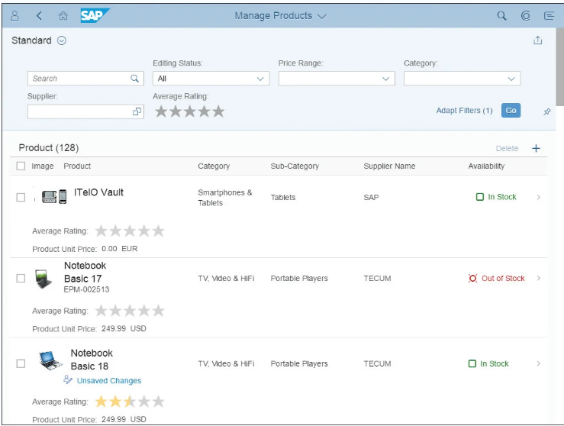
Types of SAP Fiori Element Floorplans
2
List Report Floorplan: The second type of floorplan is the List Report application, a reusable floorplan template that allows users to work with large lists of items and act on each one.
‹#›

Slide 9
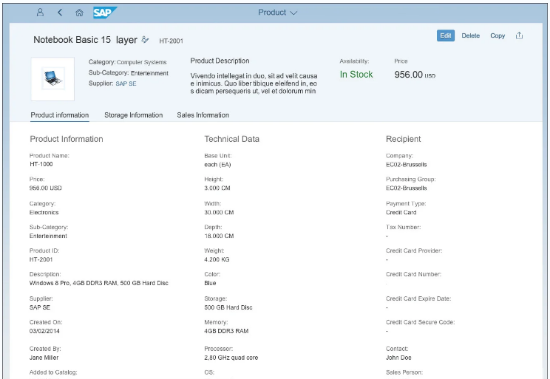
Types of SAP Fiori Element Floorplans
2
Object Page Floorplan:
Object Page (as seen below) is another type of floorplan template, which allows users to display, create, or edit an item. The Object Page floorplan can be implemented using the pre-built SAP Fiori element.
‹#›

Slide 10

CDS Views
2
The Core Data Services comprise a family of domain-specific languages which serve as a common core model for all stacks on top:
The Data Definition Language (DDL) for defining semantically rich domain data models which can be further enriched through Annotations.
The Query Language (QL) for conveniently and efficiently reading data based on data models as well as for defining views within data models.
‹#›

Slide 11
CDS Views
2
The Expression Language (EL) for specifying calculated fields, default values, constraints, etc. within queries as well as for elements in data models.
The Virtual Data Model (VDM) is a structured representation of CDS views and follows consistent modeling rules.
It provides direct access to SAP business data using standard SQL or OData requests.
‹#›

Slide 12
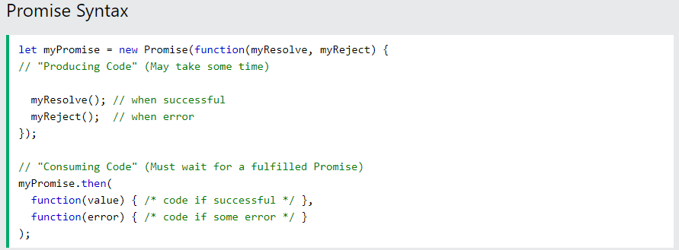
JavaScript Promises
2
JavaScript Promise Object: A JavaScript Promise object contains both the producing code and calls to the consuming code
12

Slide 13
JavaScript Promises
2
Promise Object Properties: A JavaScript Promise object can be:
Pending
Fulfilled
Rejected
The Promise object supports two properties: state and result.
While a Promise object is "pending" (working), the result is undefined.
When a Promise object is "fulfilled", the result is a value.
When a Promise object is "rejected", the result is an error object.
13

Slide 14
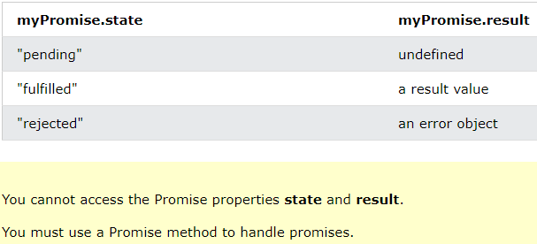
JavaScript Promises
2
14

Slide 15
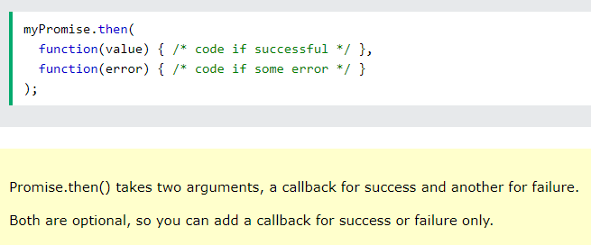
How To Use Promises
2
15

Slide 16
GITHUB Overview
2
GitHub is a web site + infrastructure that provides a Git server plus a number of really useful tools for working with git repositories individually or in teams, such as reporting issues with the code, reviewing tools, project management features such as assigning tasks and task statuses, and more.
Git is a version control system which enables you to track changes to files. It is entirely file based itself, meaning there is no additional software or applications required except Git itself.
Using Git, you are able to revert files back to previous versions, restore deleted files, remove added files and even track down where a particular line of code was introduced.
16

Slide 17
Thank you
Subscribe to our Channel for more Informative Videos.
https://www.youtube.com/user/ZaranTech

